Slide 1
A ‘superBT’ for TC Research and Forecasting Mike Fiorino Commander, United States Navy (retired) B.S. (’75 PSU), M.S. (’78 PSU), Ph.D. (’87 NPS) all in Meteorology mfiorino@gmu.edu George Mason University VA University of Colorado Boulder CO Earth System Research Laboratory, Boulder CO National Hurricane Center, Miami FL Joint Typhoon Warning Center, Pearl Harbor HI PCMDI Lawrence Livermore National Laboratory, Livermore CA European Centre for Medium-Range Weather Forecasts, Shinfield Park, Berskshire, UK Meteorological Research Institute – Japan Meteorological Agency, Tsukuba JAPAN Space and Naval Warfare Systems Command, Arlington VA NASA Goddard Space Flight Center, Greenbelt MD National Centers for Environmental Prediction, Camp Springs MD Naval Postgraduate School, Monterey CA Fleet Numerical Meteorology and Oceanography Center, Monterey CA Naval Research Laboratory, Monterey CA Atlantic Oceanographic and Meteorological Laboratory, Miami FL Pennsylvania State University, University Park PA

Slide 2
Mike Fiorino TC Bio – TCNWP
1977-1978 – first NWP TC forecast using operational analyses in a ‘full-physics’ limited-area model (Penn State w/ Rick Anthes)
1981-1983 – operational implementation of first US baroclinic, two-way interactive, moving nested-grid TC NWP model (US Navy)
1985-1988 – FNMOC-JTWC model liaison (who do you call at 0230?)
1990-2000 – TC in all reanalyses; 1.5 y secondment to ECMWF
2001-2005 – JTWC models officer and forecaster
2006-2008 – NHC models lead and forecasting
2009-2017 – HFIP project global modeling and TC genesis
2022 – AORI super Best Track
1995-2023 – WxMAP – web interface to TC and NWP for forecasting
https://jtdiag.wxmap2.com, https://tcgen.wxmap2.com, https://tcact.wxmap2.com

Slide 3
Overview key takeaways
superBT = Best Track of TCs +
BT of pTCs (potential/preTCs)
DYNAMICS – diagnostic file with storm and environment variables from ERA5
PHYSICS – TC precipitation – CMORPH & GSMaP & IMERG
STRUCTURE – R34 & ROCI/POCI (TC size) – multiple sources
climate time scales – BT of TC & pTCs of primary importance, especially pTCs for TC genesis
ERA5 TC forecasts are very good with consistent quality over the 43-y period 1979-2022 ➔ ERA5 analyses are very good
3 (semi-independent) satellite and gauge precipitation analyses
entire NWP/TC/reanalysis s/w & data installed & working at climateb.aori.u-tokyo.ac.jp

Slide 4
…at the outset…
A ‘super’ Tropical Cyclone (TC) Best Track (BT) is only as ‘super’ (good) as the BT itself…made by humans
SHEM 1990-2022 (~30 y)
NHEM: 1980-2022 (~40 y)

Slide 5
BT part of the superBT
BT data comes from JTWC & NHC
global
consistent operations for best tracking and forecasting
consistent metrics – knots, nautical miles, 1-minute average surface (10-m) wind
common data format (ATCF)
consistent initiation of INVESTS or pre-potential TC (pTC) disturbances → specialized-localized satellite reconnaissance and tracking/model diagnostics
JTWC has not issued a warning without starting an INVEST since 2005…only one case…
only in recent years has JTWC/NHC properly maintained the INVEST or pTC data set…I have maintained since 2007-2022 and in some basins back to 1999 (courtesy of NRL Monterey)

Slide 6
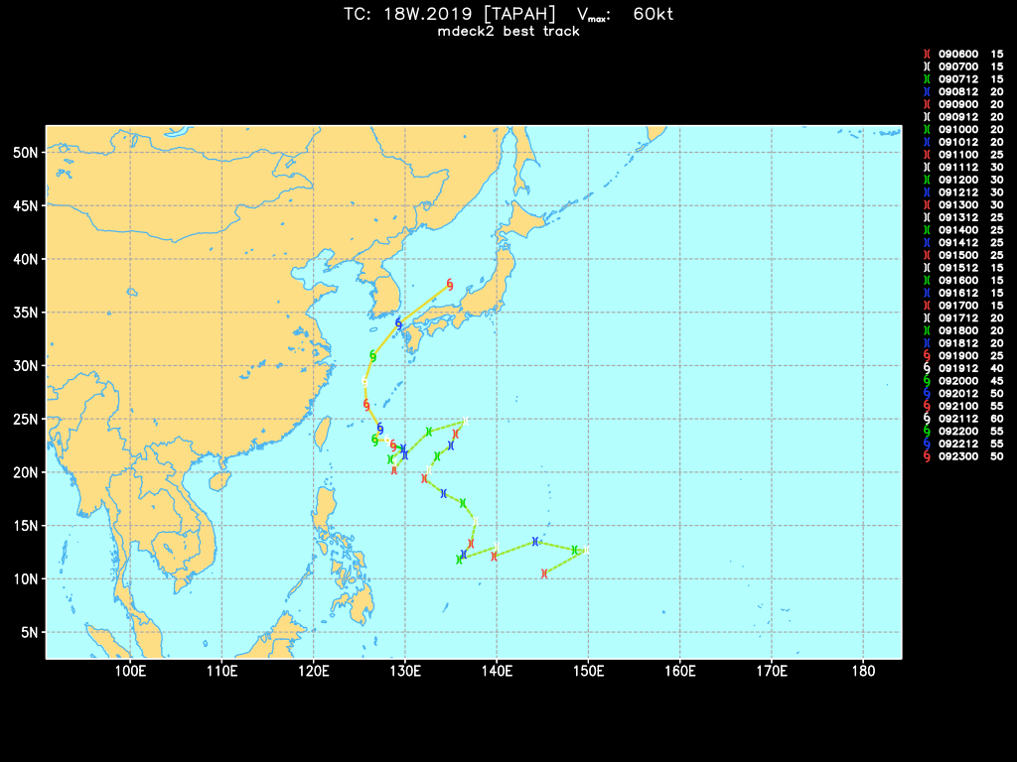
18W.2019 – TS TAPAH w2-tc-dss-md2-anl.py –S 18w.19 -X
a pTC for 312 h before JTWC issued warnings (genesis)

Slide 7
BT part of the superBT
the superBT converts all the operational TC data into .csv files that drive all applications (python and pandas).
1947-2022
< 1900 in the atLANTic
for HURACAN applications will look at:
TC activity
TC genesis or TC formation from a pTC

Slide 8
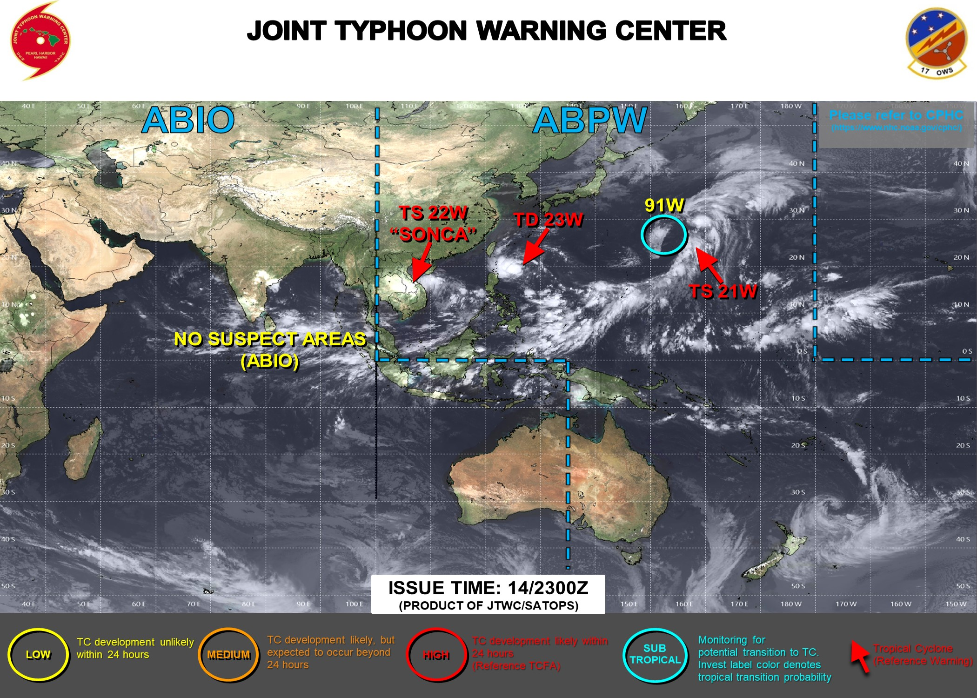
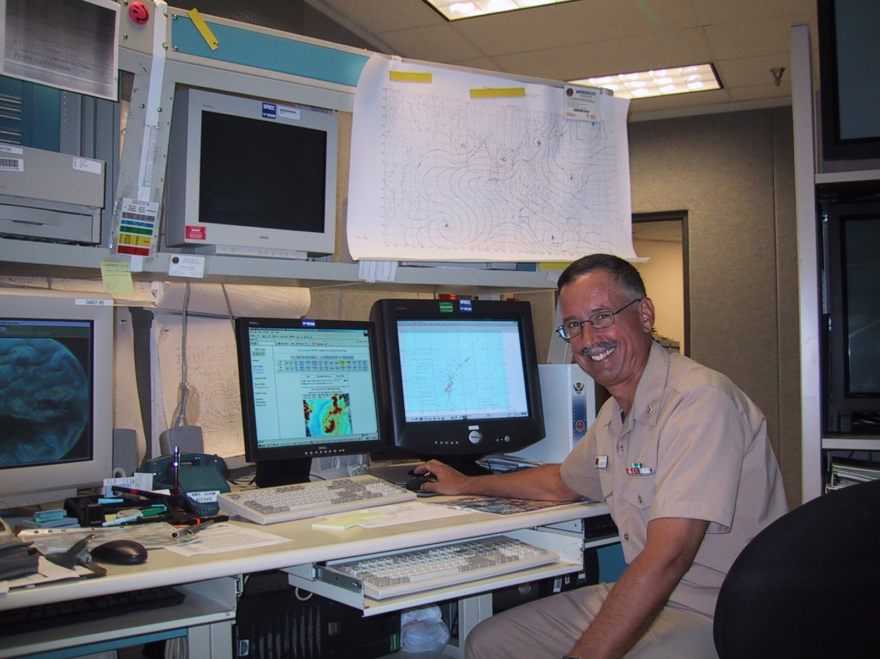
Best Track from the Operational Centers
INVEST (91W) or pTC that is Subtropical
final warning on TC 21W – classified as XT or eXtra Tropical
warning on a TC with winds < 35 kt

Slide 9
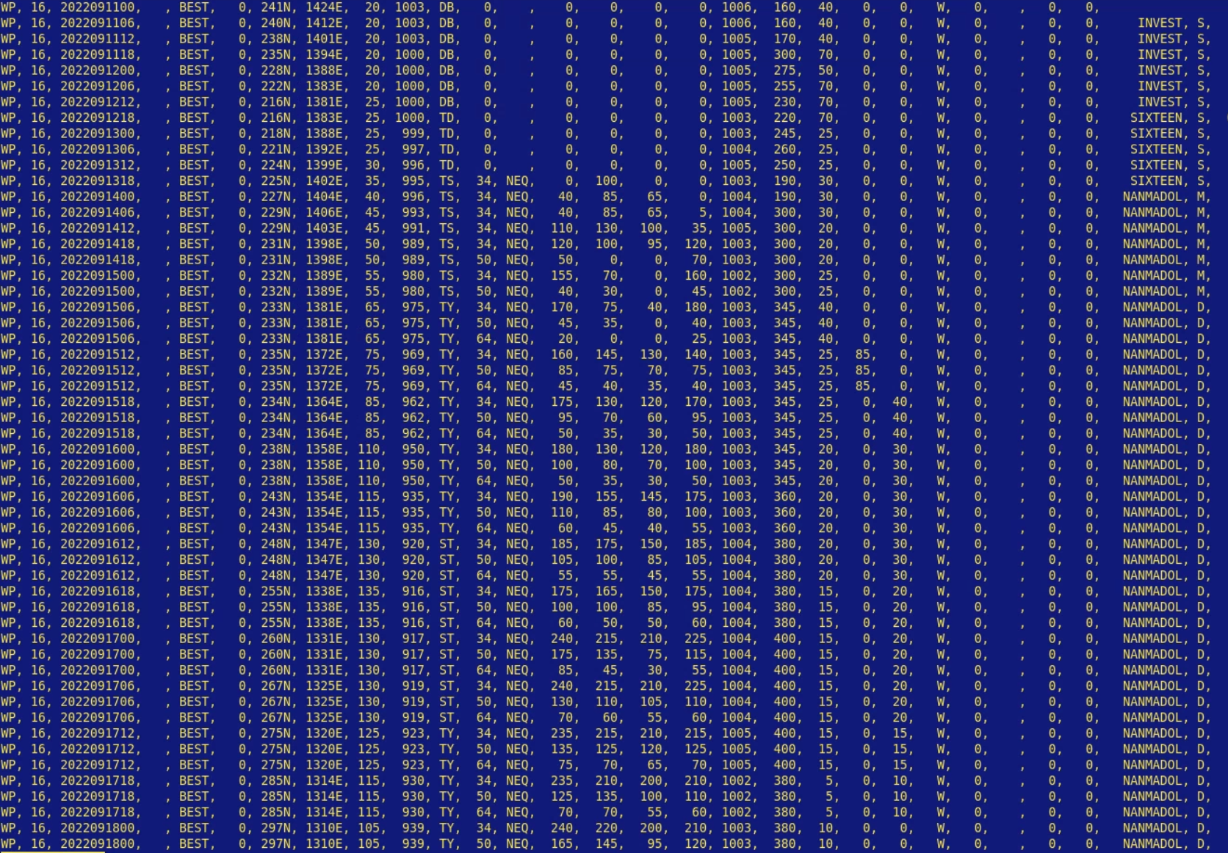
16W.2022 NANMODAL ‘bdeck’ text file /braid1/mfiorino/w22/dat/tc/bdeck/jtwc/bwp162022.dat
ATCF format – .csv 29 columns (~WMO standard)
storm id, date-time,
position: lat, lon,
intensity: Vmax, pmin,
classification: SD/SS/LO/DB/TD/MD/TS/TY/STY
34/50/65 kt wind radii
POCI, ROCI (Pressure and Radius of Outermost Closed Isobar)
eye diameter, Rmax, name
depth code: S/M/D

Slide 10
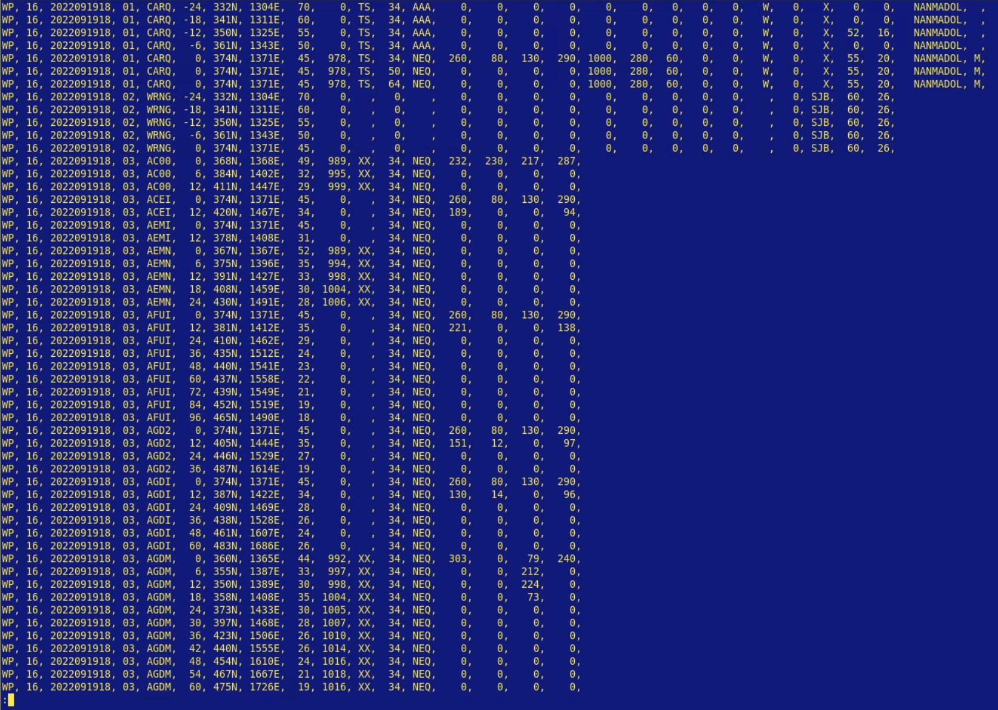
16W.2022 NANMODAL ‘adeck’ /braid1/mfiorino/w22/dat/tc/bdeck/jtwc/awp162022.dat
ATCF format – .csv 29 columns
operational information including forecaster initial (SJB = Steve Barlow)
previous 12, 24 h positions
converted into standard WMO format and sent to operational NWP centers for ‘bogussing’ or TC vortex analysis/initialization…

Slide 11
bdeck & adeck converted to ‘mdeck’ or merged deck
mdeck has all storm information from both data files
turned into a .py object with ‘variables’ and ‘methods’ for easy access in .py
more significantly … mdecks for each pTC maintained
pTCs are coded as 9XB (X → 0,1,...,10 B →basin ID W-Western North Pacific (0-90N, 100E-180E)
in one year there will be multiple 90W
each instance is coded with letter. first → A, second →B
91W from JTWC above is actually H1W or the 8th 91W
actively maintained in .zip files from both centers since 2007 – the only properly maintained pTC data set
essential for TC genesis studies

Slide 12
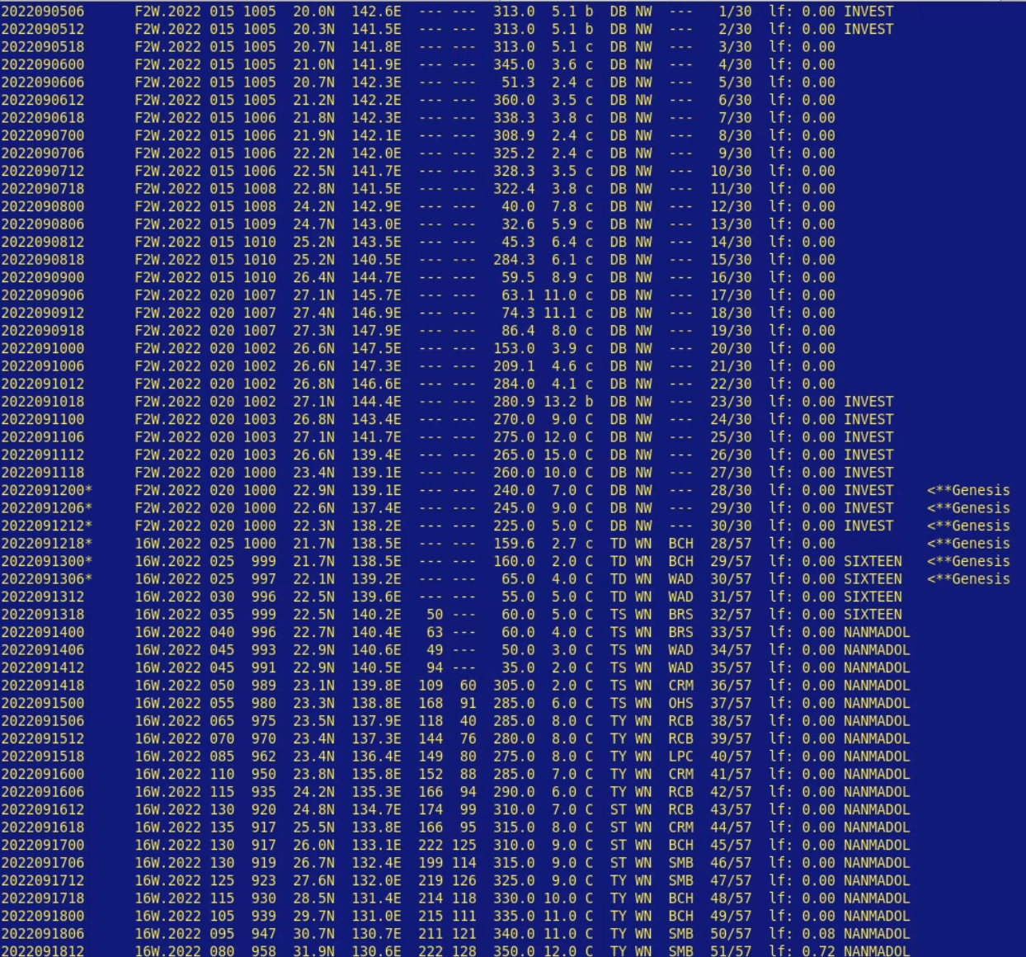
16W.2022 NANMODAL mdeck w2-tc-dss-md2-anl.py –S 16w.22
was a pTC for 180 h or 7.5 d

Slide 13
16W.2022 NANMODAL mdeck w2-tc-dss-md2-anl.py –S 16w.22
summary stats
sACEd
summary stats
lat/lon range
summary stats
ED – Explosive Deeping >= 50 kt / 24 h
summary stats
time to genesis and pTC

Slide 14
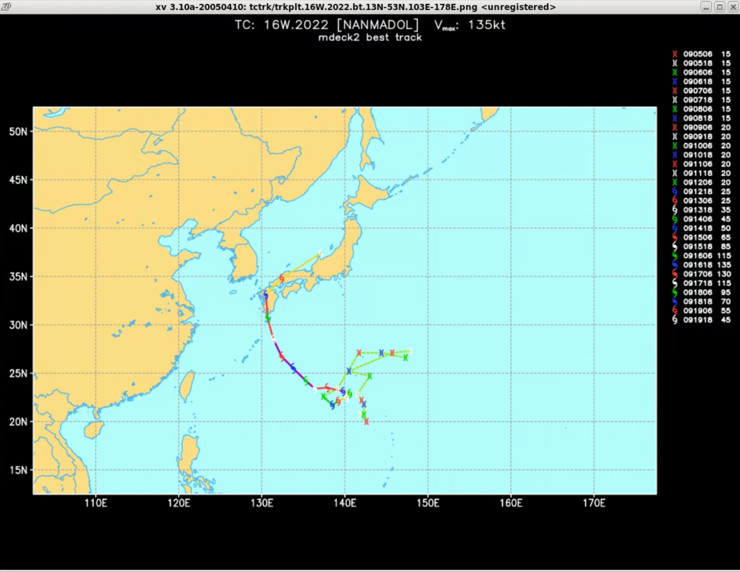
16W.2022 SuperTyphoon NANMODAL w2-tc-dss-md2-anl.py –S 16w.22 –X
pTC stage
as 92W (F2W)

Slide 15
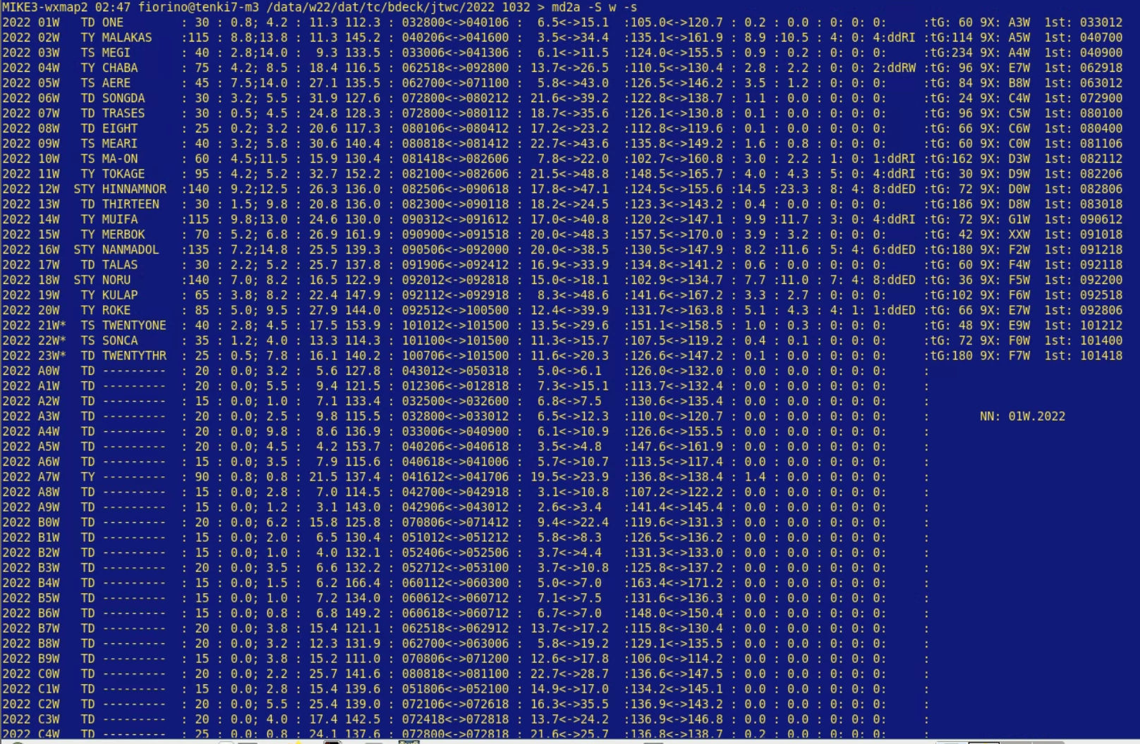
WPAC 2022 summary w2-tc-dss-md2-anl.py –S w.22 -s
9 of 24 storms did RI
Rapid Intensification (30 kt / 24 h)
4 of 9 RI storms did ED
Explosive Deepening (50kt / 24h)
WPAC 2022 summary 23 NN storms or 23 TC
61 9X storms or 61 pTCs
formation rate: 23/61 = 38%
38% of pTCs became TCs and 62% did not

Slide 16
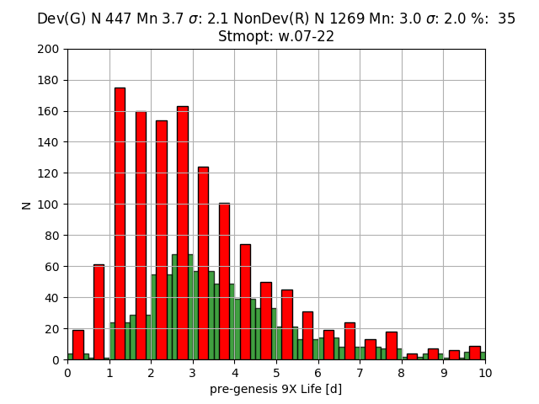
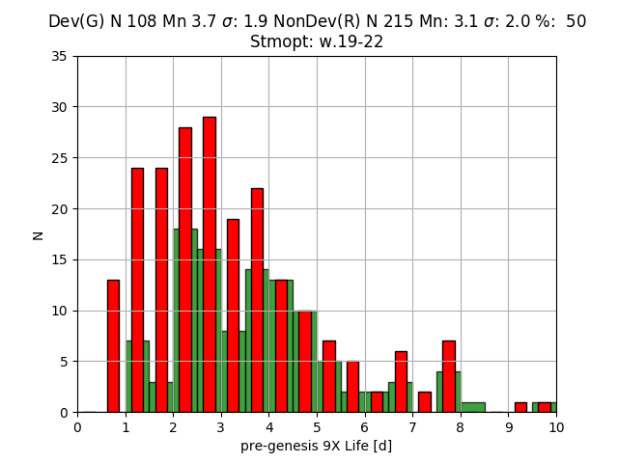
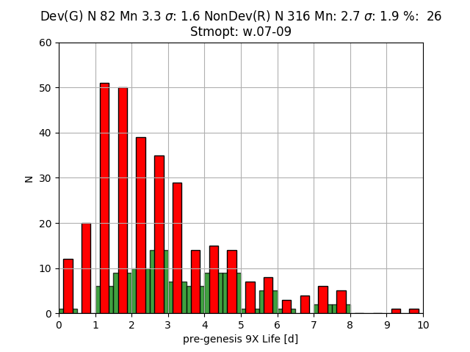
WPAC 2007-2022 (15 y) Seasonal Formation Rate (#TC/#pTCs) & time to genesis (from pTC →TC)
WPAC
2019-2022
F=50%
Tg=3.7d
WPAC
2007-2022
F=35%
Tg=3.7d
WPAC
2007-2009
F=26%
Tg=3.3d

Slide 17
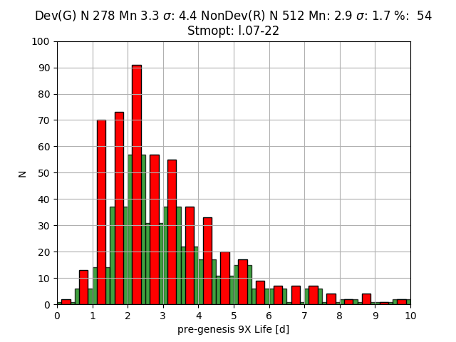
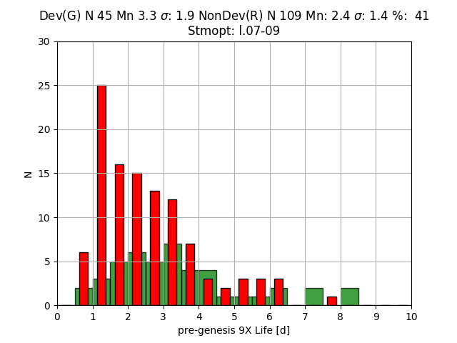
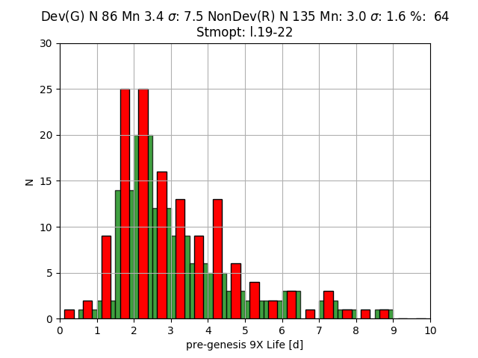
LANT 2007-2022 (15 y) Seasonal Formation Rate (#TC/#pTCs) & time to genesis (from pTC →TC)
LANT
2019-2022
F=64%
Tg=3.4d
LANT
2007-2009
F=41%
Tg=3.3d
LANT
2007-2022
F=54%
Tg=3.3d

Slide 18
Summary in NHEM basins formation rate (%) & days to genesis (d)
Basin | 2007-2009 |  |  | 2019-2022 |  | 2007-2022
WPAC | 26% | 3.3d |  | 50% | 3.7d | 35% | 3.7d
EPAC | 71% | 2.5d |  | 73% | 3.2d | 68% | 2.8d
LANT | 41% | 3.3d |  | 64% | 3.4d | 54% | 3.3d
NHC & JTWC started more invests (9X or pTC) in the early period (2007-2009) in WPAC and the LANT
EPAC has highest formation rate (~68%) and fastest time to genesis (~2.8 d)
WPAC lowest formation rate (~35%) and slowest time to genesis (~3.7 d) → more pTCs

Slide 19
Summary of pTC→TC
15 years of global pTC data may be long enough to establish a climatology of pTC formation and TC genesis
there are (many) more pTCs than TCs
30-70% of the pTCs tracked by JTWC/NHC become TCs
more pTCs in WPAC (monsoon trough) than in EPAC/LANT
the mean time from the start of a pTC to forming a TC is about 3 days
TC genesis studies should account for the pTC stage – a complex accounting problem
understanding environmental differences between developing and non-developing pTCs requires global modeling – reanalysis – NWP

Slide 20
some words of wisdom…
“You’re only as good as what you measure”
CAPT Vic Addison, USN(ret)
2006 Commanding Officer FNMOC
“Forecasting is the acid test of an analysis”
Bob Kistler, NCEP
father of American Reanalysis
NCEP/NCAR R1

Slide 21
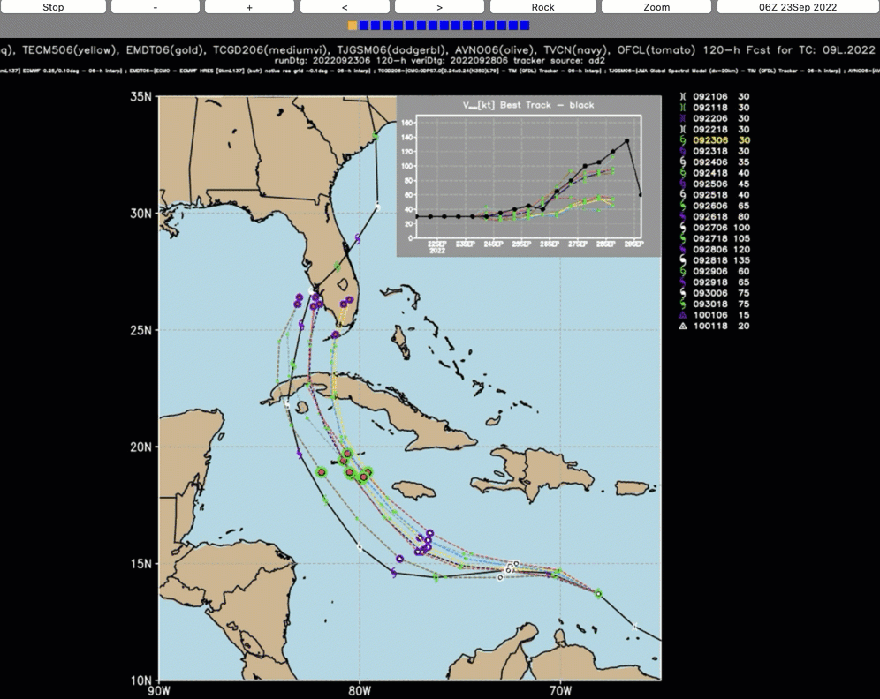
NWP – hurricane IAN https://tctrkveri.wxmap2.com
Ave Maria FL

Slide 22
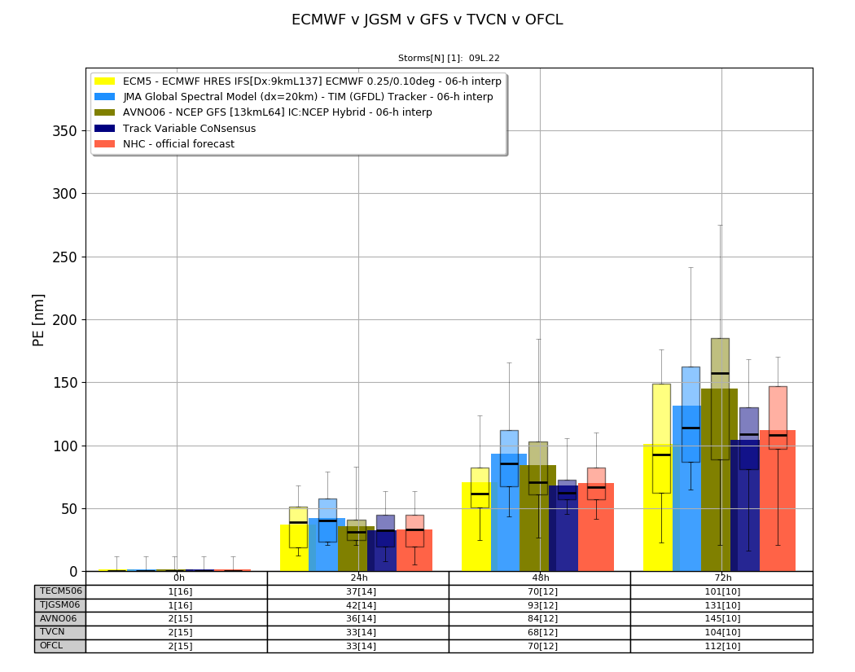
NWP – hurricane IAN verification – mean position error (PE)
09L
NHC 112 nm
ECMWF 101nm
JGSM 131 nm
TVCN 104 nm

Slide 23
NWP – WPAC & LANT 2022 verification – mean position error (PE)
WPAC~120nm
ECMWF 113 nm
JGSM 127 nm
GFS 123 nm
LANT~80 nm
ECMWF 71 nm
JGSM 73 nm
GFS 79 nm

Slide 24
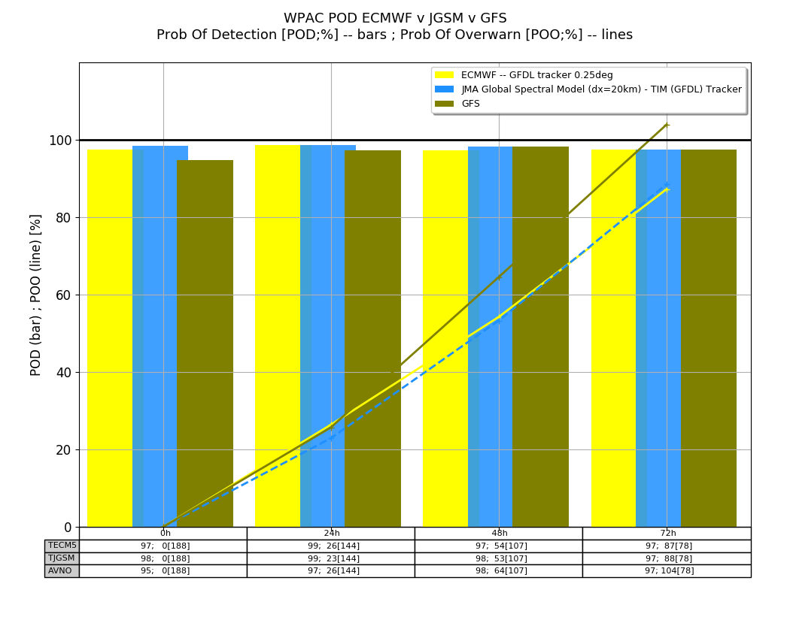
NWP PoD – Probability of Detection WPAC 2022
Tau=72 ~ 97%
Tau=0 ~ 98%

Slide 25
NWP metrics 2022
Good 72 mean PE → 100 nm
~ 120 nm in WPAC
~ 100 nm in LANT
Good PoD → 95-100%
tau 0 (initial) ~ 98%
tau 72 (72-h forecast) ~ 95%
How does ERA5 compare to ERA15/40?

Slide 26
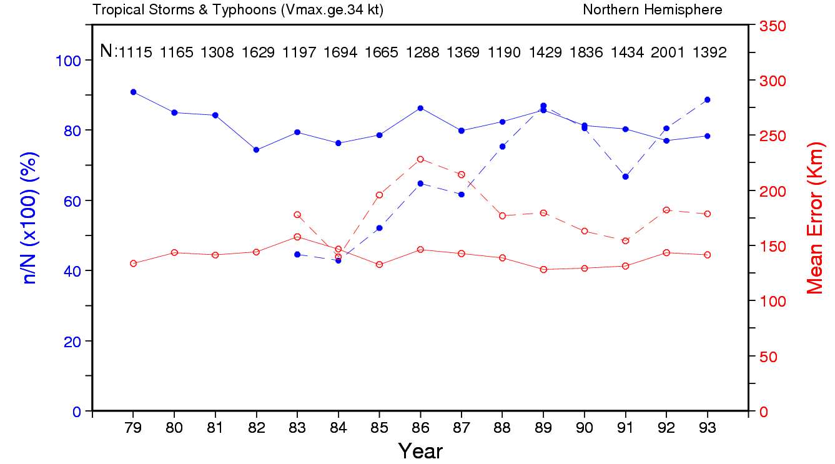
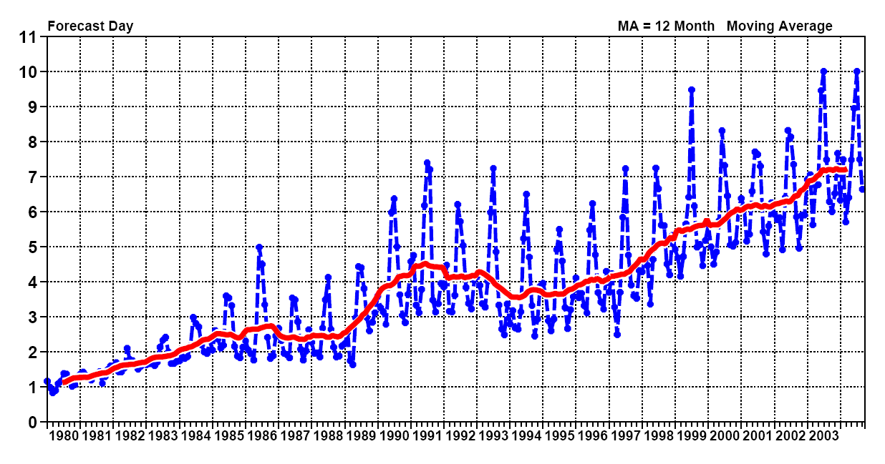
TC Detection in ERA-15 v ECMWF ops
ERA-15 ~85% 1979-93
Ops detection increases to 80+% ~1989
tropical wind skill increases from 2.5 to 4 days ~1989

Slide 27
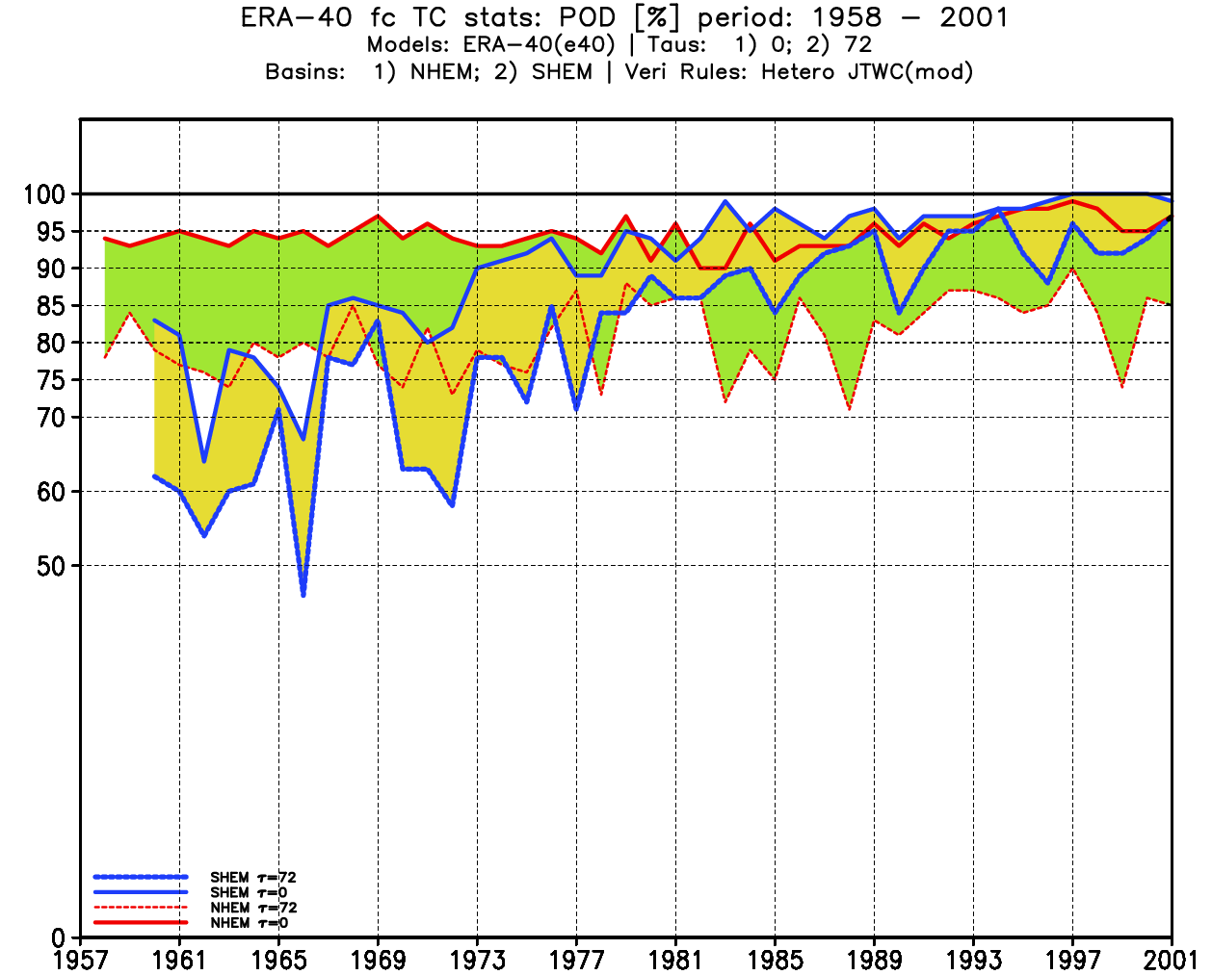
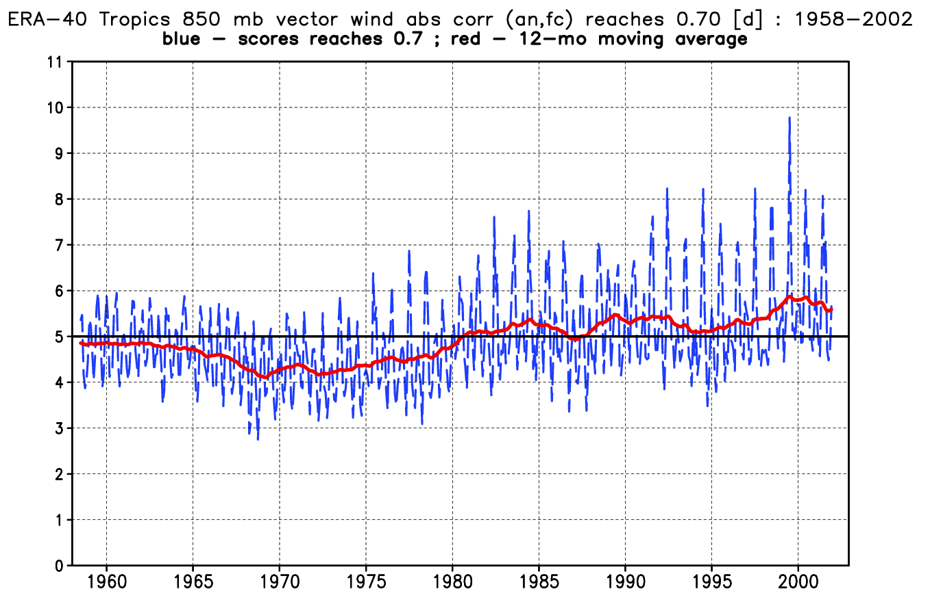
ERA-40 TC detection v tropical wind score SHEM v NHEM ; tau=0 v tau=72 h

Slide 28
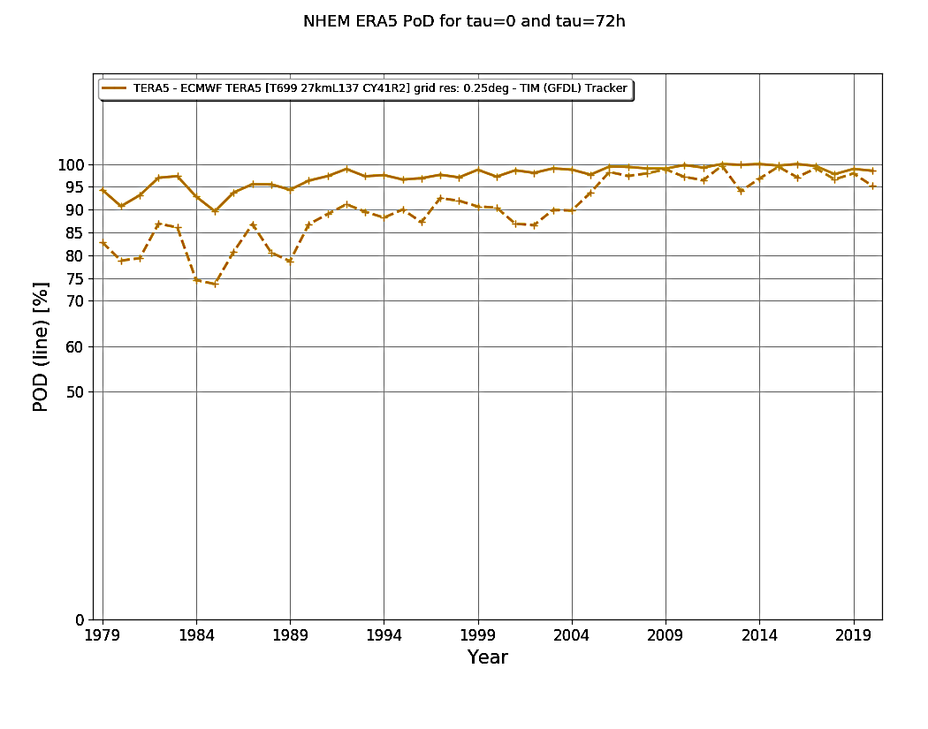
NHEM ERA5 PoD at tau=0 and 72 h
tau0 >= 90% and better than ERA40 1989-2021
tau72 much better

Slide 29
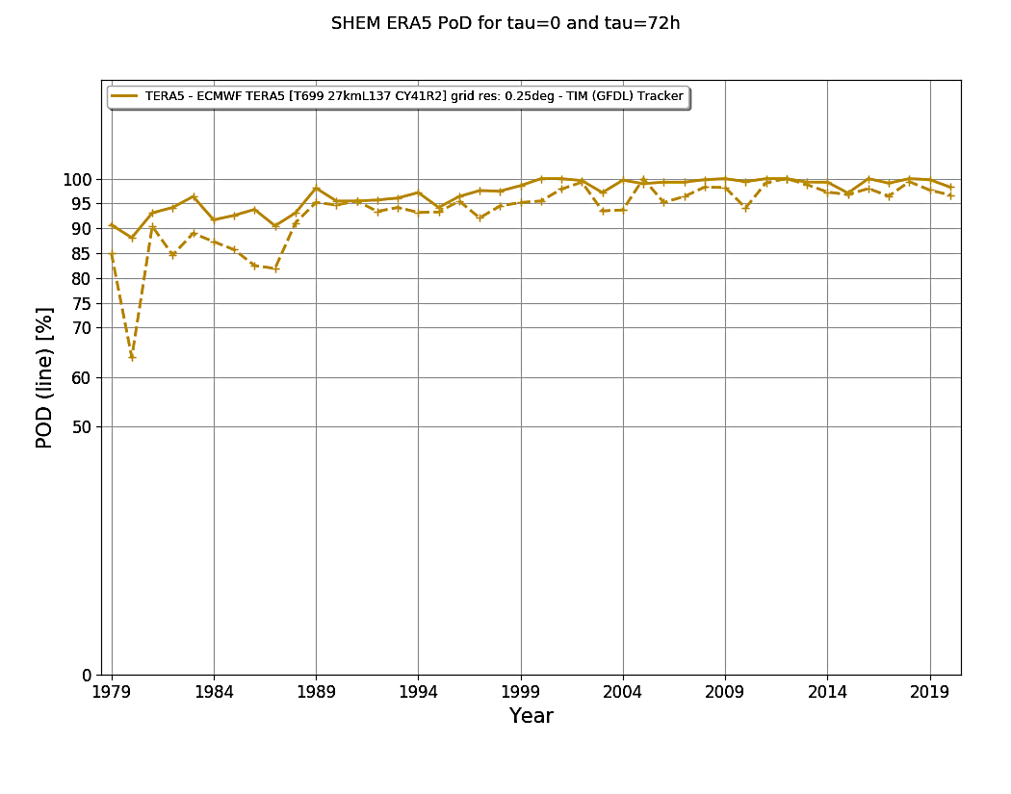
SHEM ERA5 PoD at tau=0 and 72 h
both tau0 and tau72 are way better than ERA40! and similar to NHEM

Slide 30
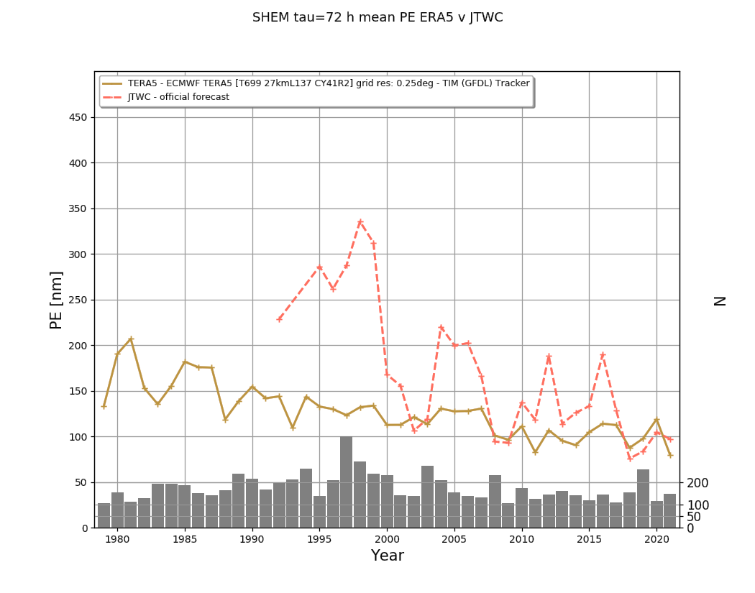
SHEM ERA5 v JTWC mean 72-h PE

Slide 31
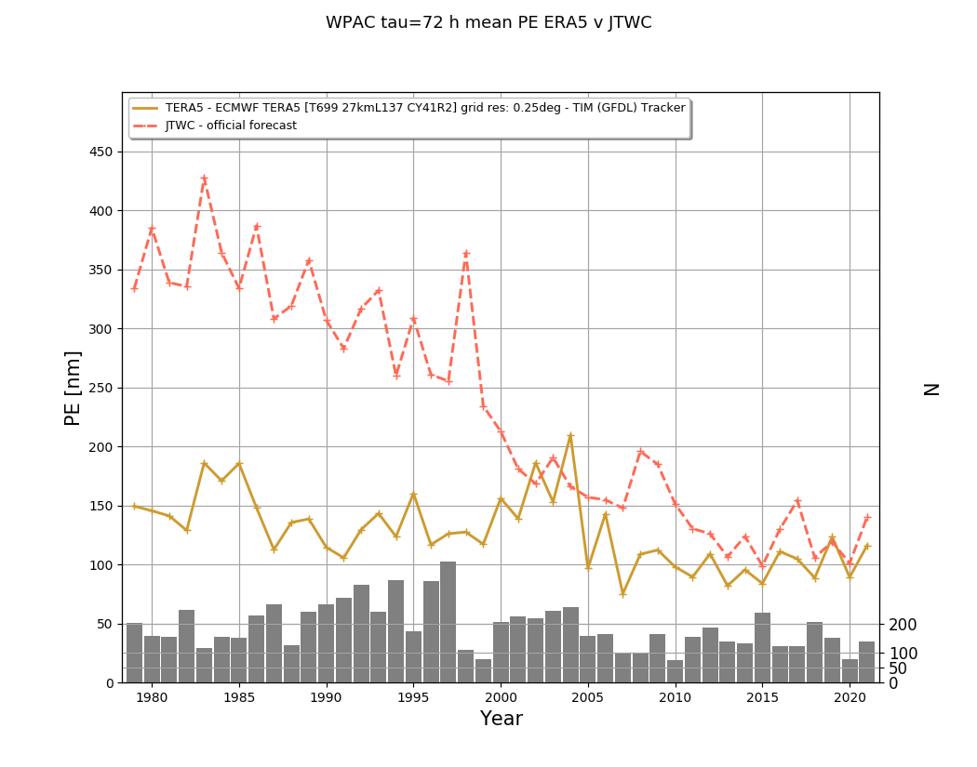
WPAC ERA5 v JTWC mean 72-h PE

Slide 32
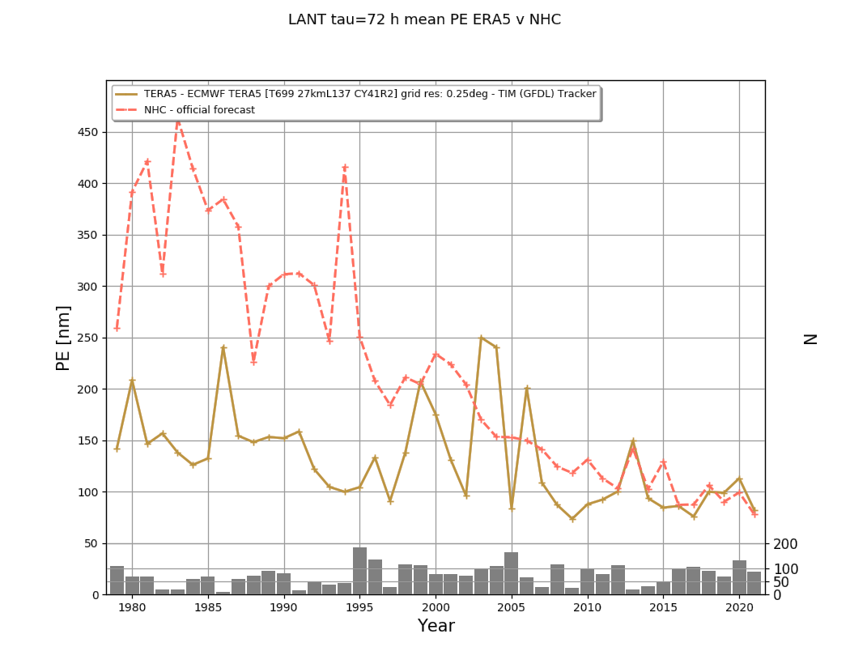
LANT ERA5 v NHC mean 72-h PE

Slide 33
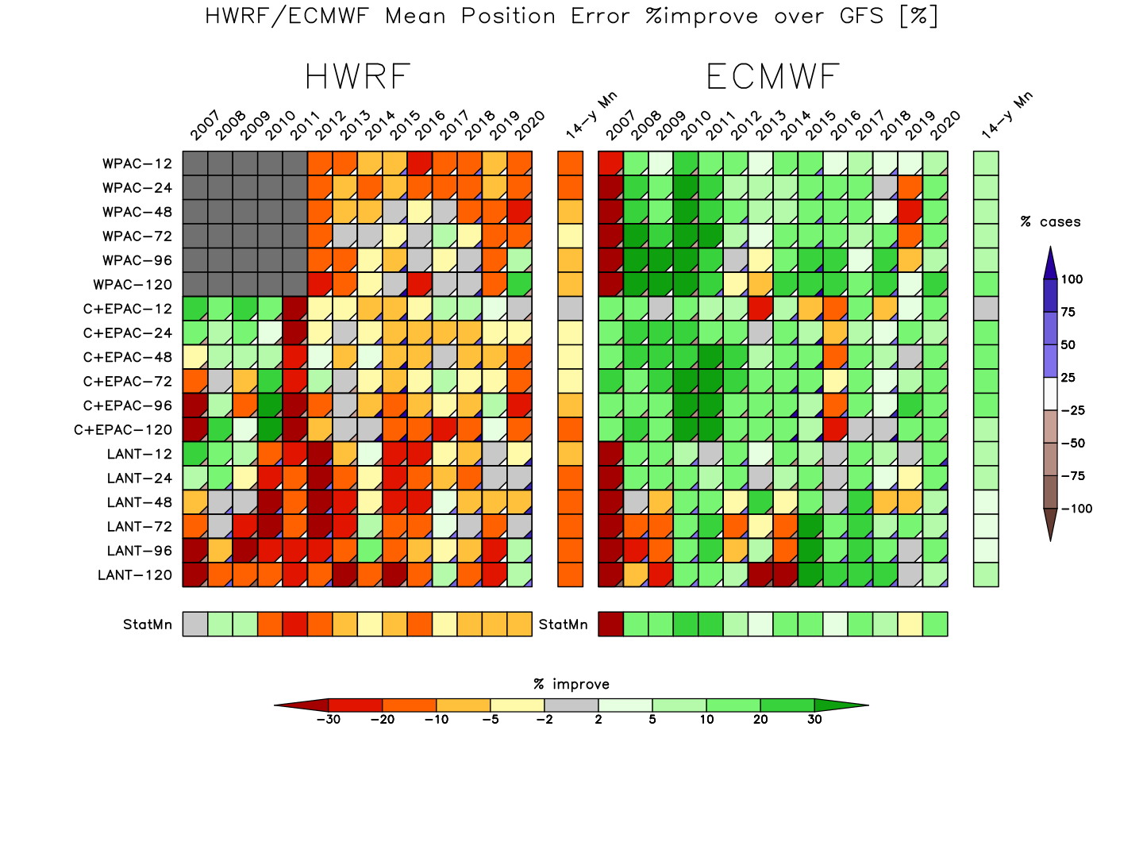
HWRF v ECMWF v GFS 2007-2020 % improve (lower) mean PE relative to GFS as a baseline

Slide 34
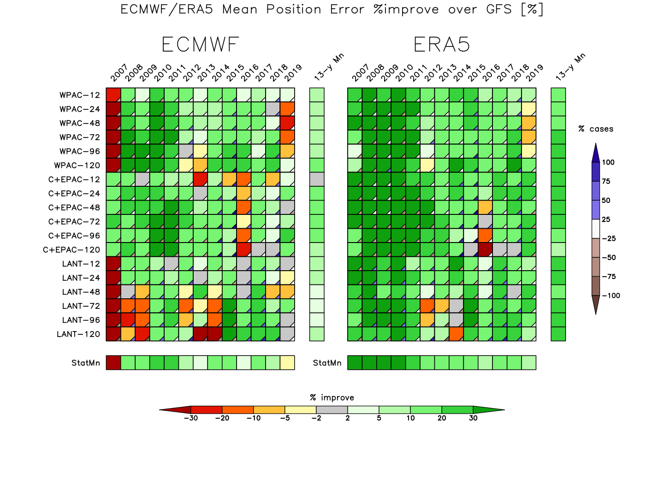
ECMWF v ERA5 v GFS 2007-2019 % improve (lower) mean PE relative to GFS as a baseline

Slide 35
Precipitation Data Sets
CMORPH – NOAA 1998-2022
GSMaP – JAXA 2001-2022
IMERG – NASA 2001-2022
high spatial/temporal resolution satellite-based
ERA5 – model 6- and 12-h accumulation on 0.25deg grid (near native res)
regrid to a common grid (0.25deg 6-h) for apples-to-apples comparison

Slide 36
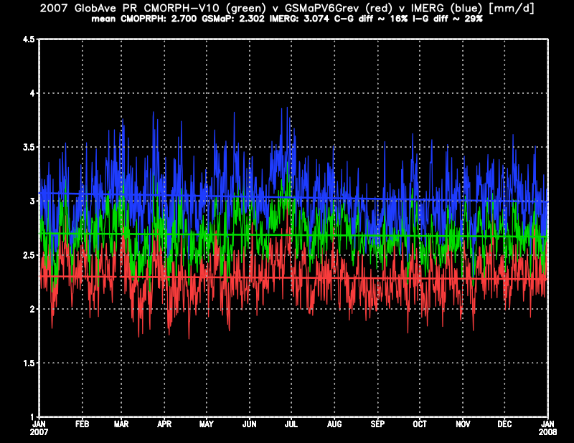
2007 global average precip

Slide 37
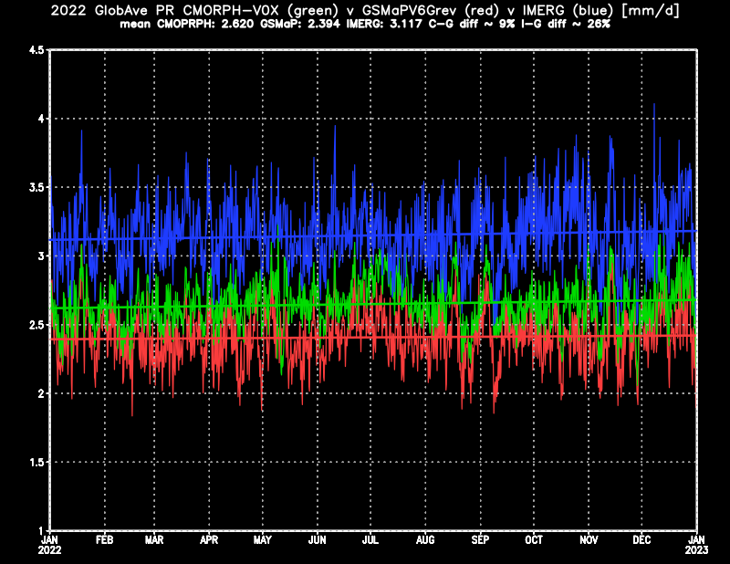
2022 global average precip

Slide 38
Dev v NonDev pTCs
global-mean precipitation
GSMaP low (2.2 mm/d)
IMERG high (3.0 mm/d)
CMORPH in the middle (2.4 mm/d)
precip relative to pTCs
CMORPH is different/outlier,
GSMaP & IMERG closer with more rain in IMERG
IMERG may be best…
ERA5 dynamics
850-200 hPa wind shear
model TC intensity

Slide 39
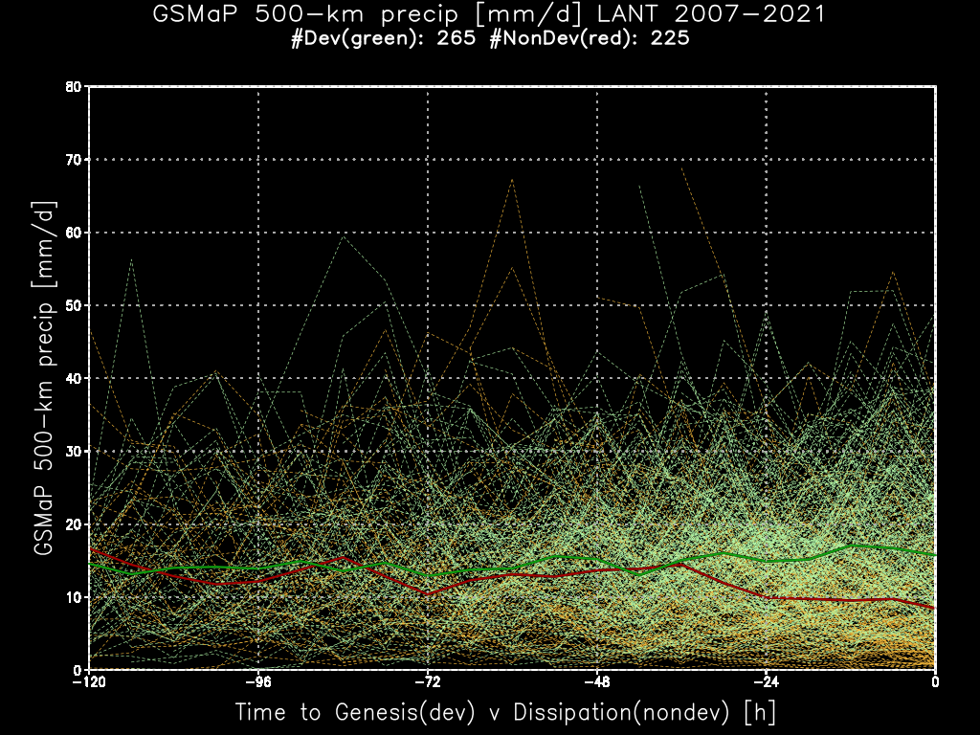
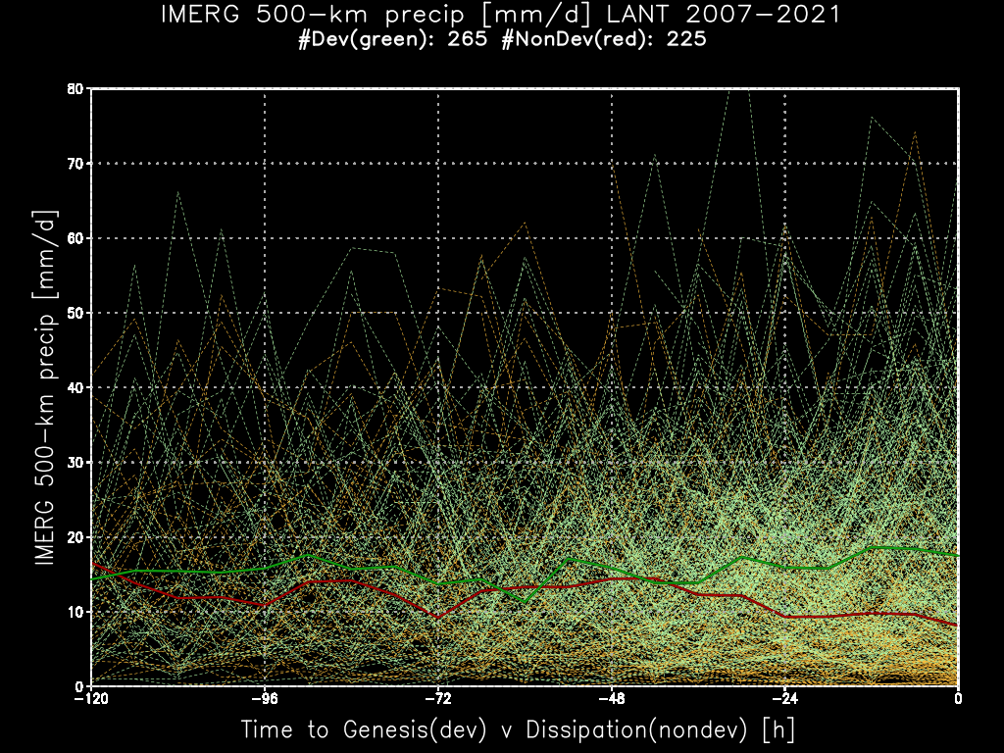
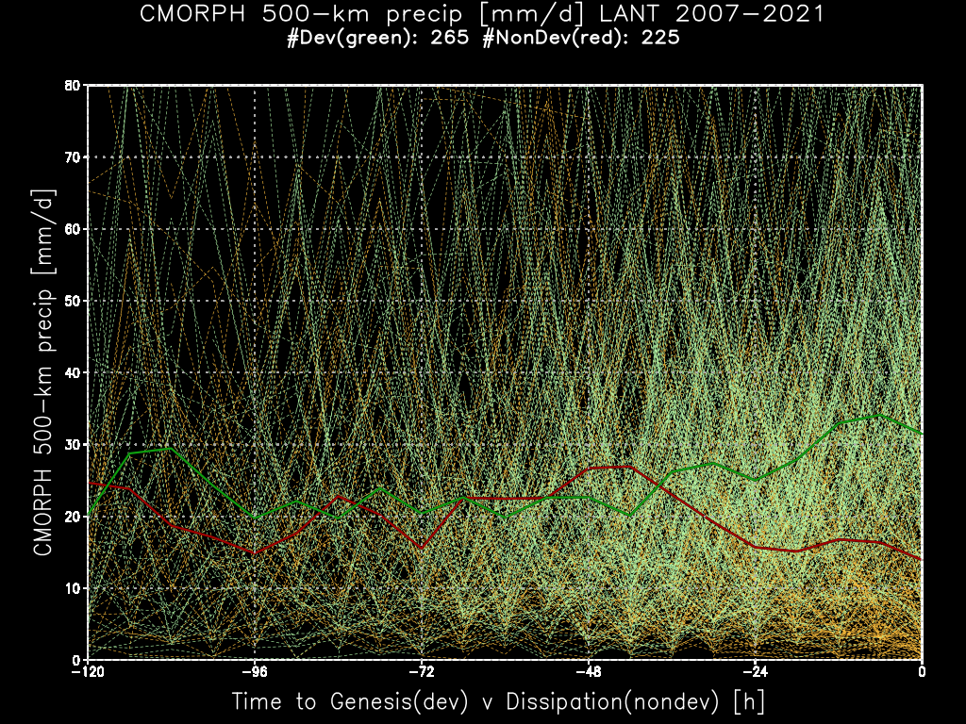
r=500 km area average – LANT

Slide 40
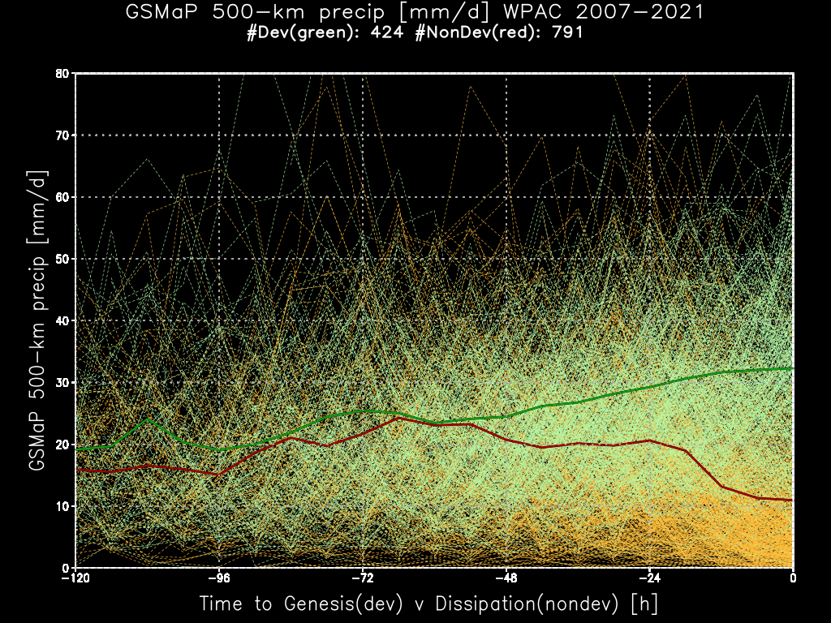
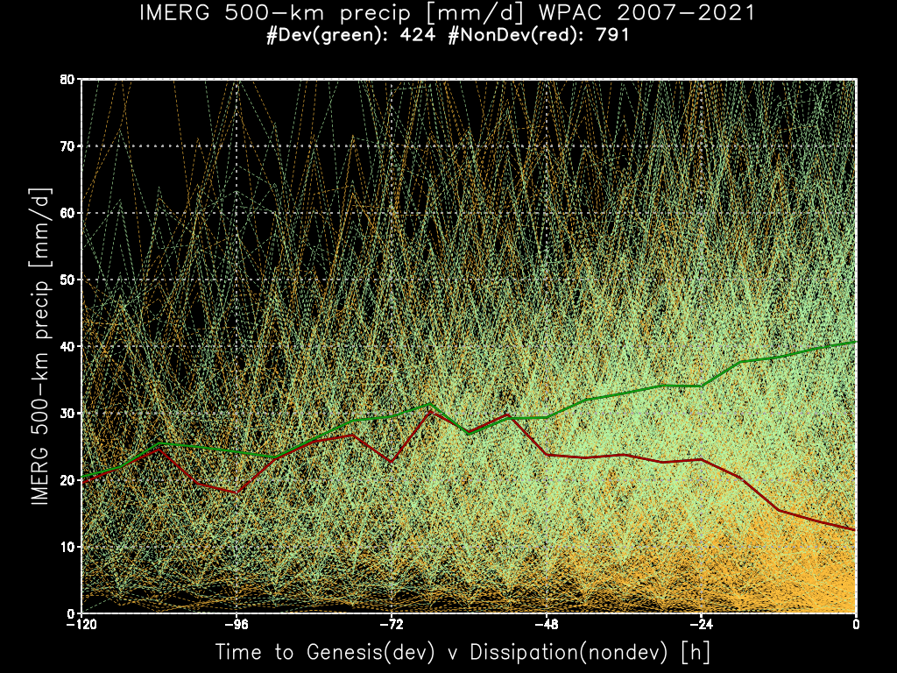
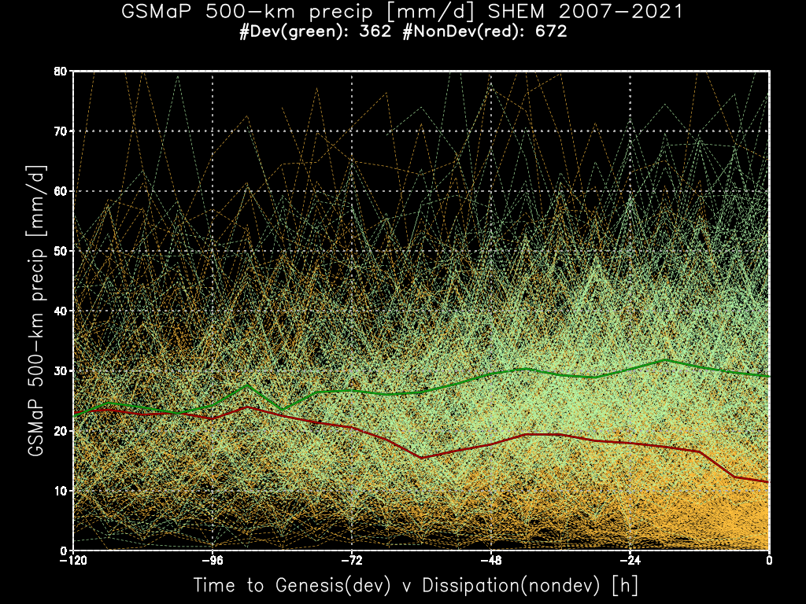
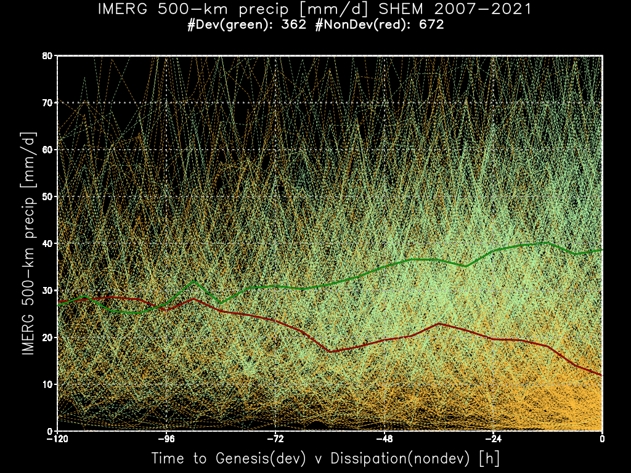
r=500 km area average – WPAC/SHEM

Slide 41
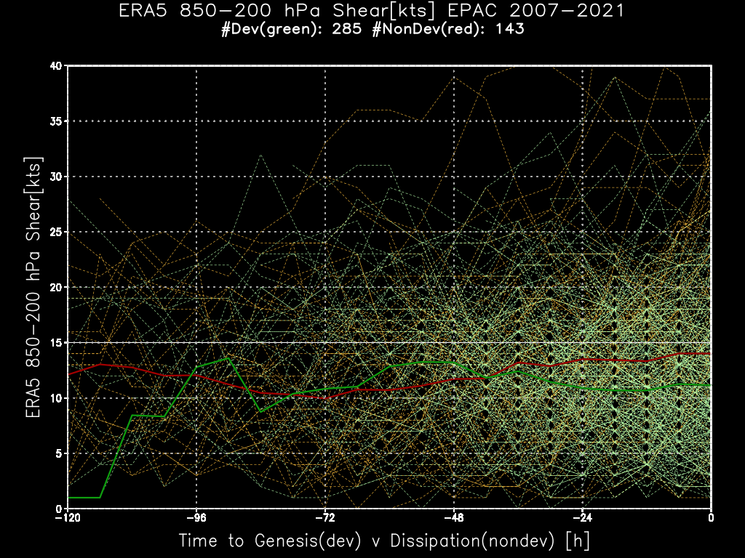
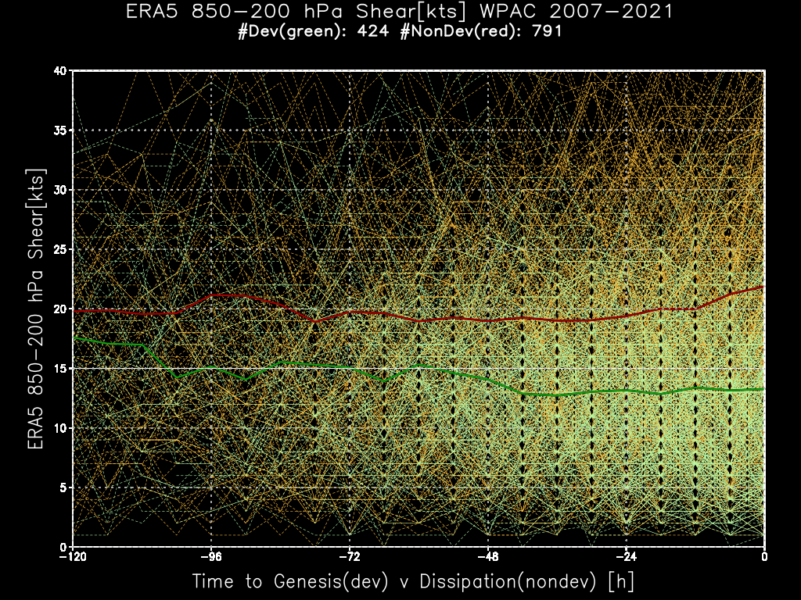
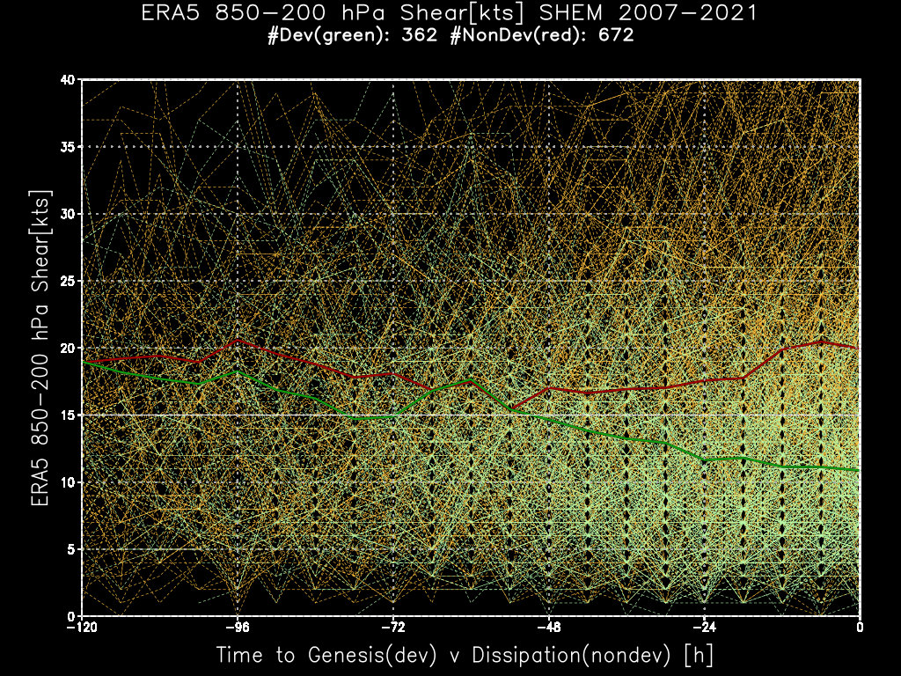
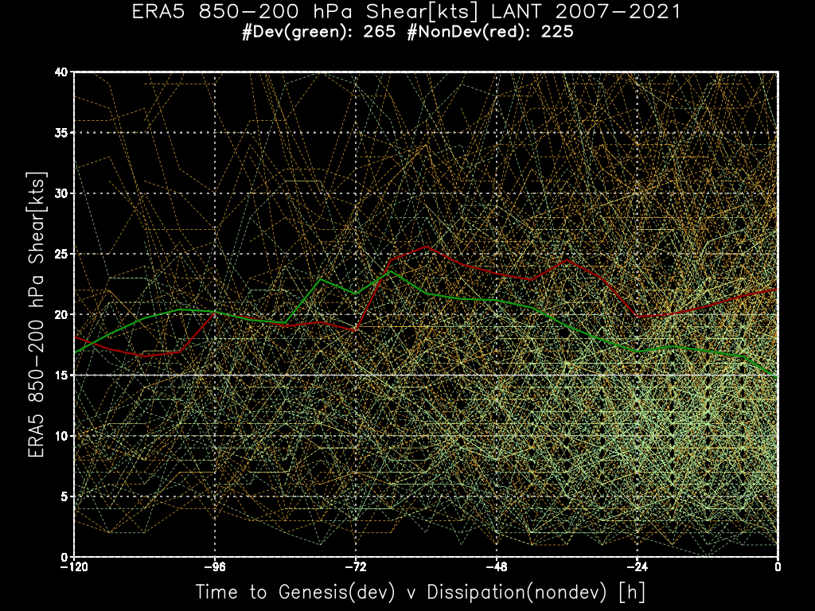
ERA5 dynamics – 850-200 hPa Shear

Slide 42
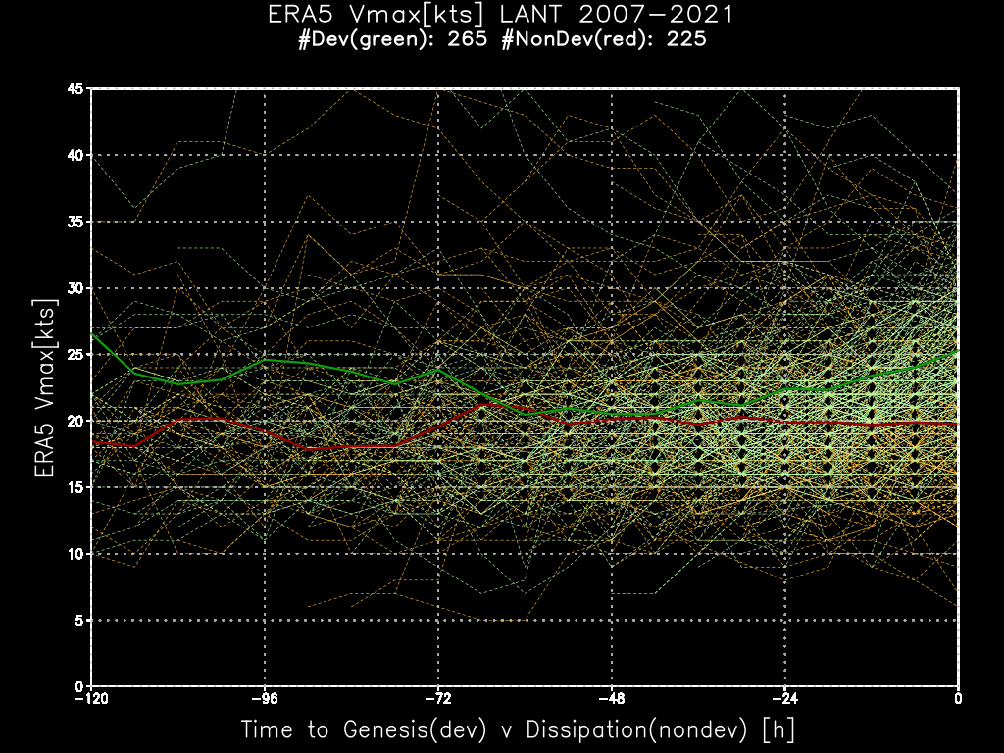
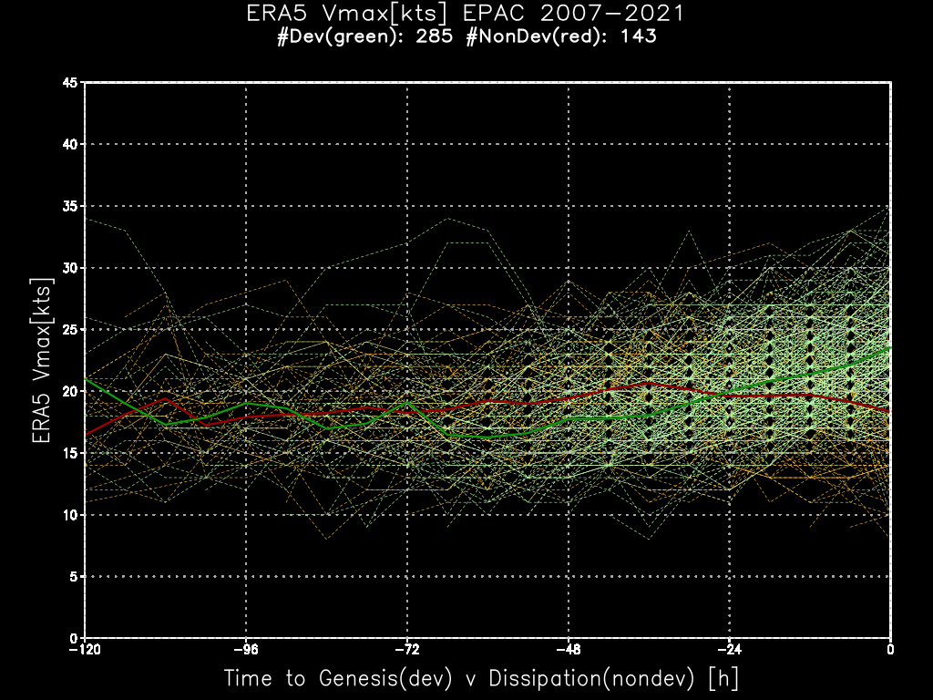
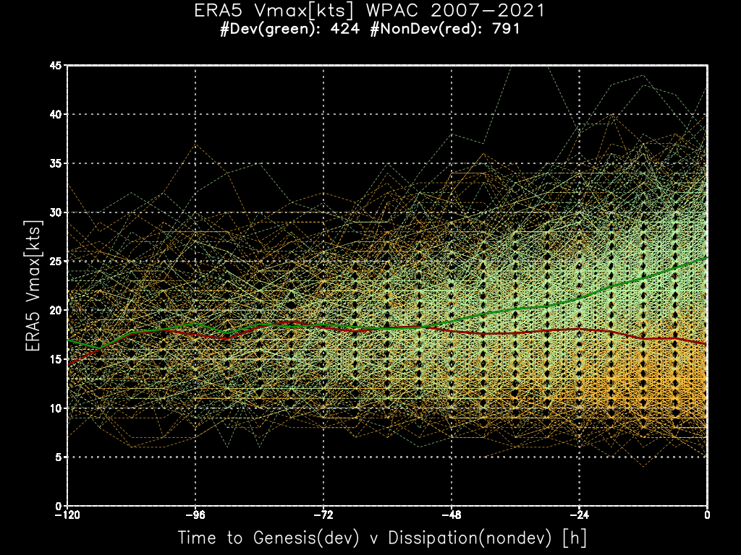
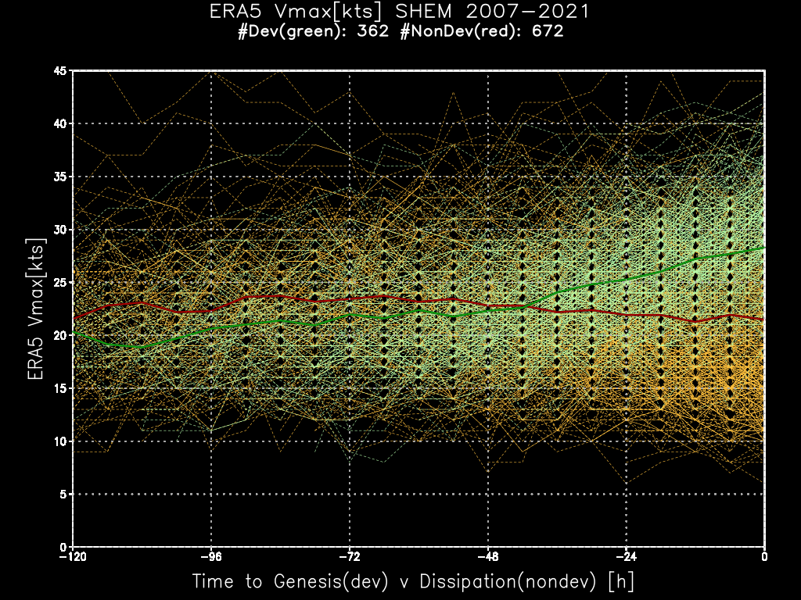
ERA5 – Model Vmax

Slide 43
Dev v NonDev TCs
Shear very different between the basins, but in developing pTCs the shear drops
ERA5 model developing pTCs intensify before genesis ~48 h beforehand
Similar anticipation in 500-km mean pTC precip…departure point betwee dev and nondev > 48 h
Only first steps in analyzing the superBT dev v nondev

Slide 44
Takeaways
superBT = Best Track of TCs +
BT of pTCs
diagnostic file with storm and environment variables
storm structure – R34 & ROCI/POCI (TC size) – multiple sources
TC precipitation – CMORPH & GSMaP & IMERG
climate time scales – BT of TC & pTCs of primary importance, especially pTC for TC genesis
ERA5 TC forecasts very good with consistent quality over the 43-y period 1979-2021 ➔ analyses are very good

Slide 45
Next steps…
Version 1.0 of superBT
by storm pTC & TC
TC vitals (lat/lon/Vmax/speed/direction…)
ERA5, CMORPH/GSMaP/IMERG rain area-average at r=300, 500, 800 km
Version 2.0
ROCI/POCI/R34 & more diagnostic variables
1979-2022

Slide 46
Acknowledgements
AORI
a big shoutout
まいどどうもありがとございました!
Takayabu-sensei
and her staff
for sponsoring this visit
and the opportunity to do science again
GMU
Jim Kinter
sponsoring my affiliation and access
to computing and the library

Slide 47
My entire NWP/TC s/w & data installed & working at climateb.aori.u-tokyo.ac.jp
JTWC/NHC best tracks and forecast aids (1947-2022)
CMORPH precip, CIRA MTCSWA (1998-2022)
ERA5 forecasts and analyses (1979-2021)
real-time JTWC/NHC data (crontab)
front-end and back-end processing
wxmap2.com – front end web interface to products
https://maps.wxmap2.com WxMAPs
https://tcact.wxmap2.com TC activity sACEd
https://tcgen.wxmap2.com TC genesis
https://jtdiag.wxmap2.com TC diagnostics file
https://tceps.wxmap2.com TC ensemble file
https://tctrkveri.wxmap2.com TC tracks & verification

Slide 48
Change gears – pTCs to TC activity
superBT has a unique pTC data set
more pTCs in WPAC than LANT → formation mechanism
WPAC – monsoon trough
LANT – tropical/easterly waves coming off Africa

Slide 49
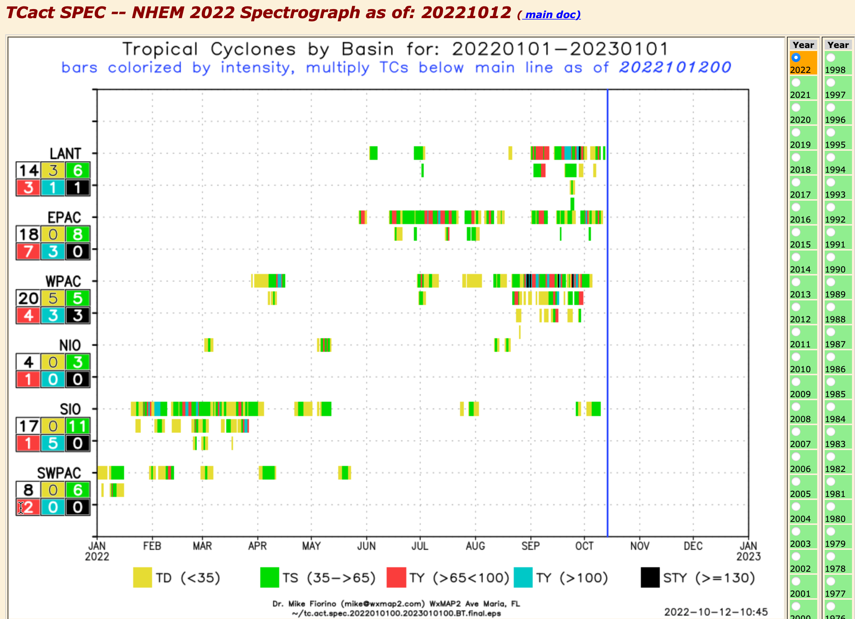
https://tcact.wxmap2.com spectograph

Slide 50
TC activity metrics
# of storms by intensity (JTWC – supertyphoon, NHC – CAT1-5)
wind-duration metrics:
Mike: Vmax x duration, e.g., 60kt*6h
G. Bell: ACE – Accumulated Cyclone Energy – Vmax**2 * 6h
M. Powell: IKE – Integrated Kinetic Energy = f(R34,Vmax)
K. Emanuel: Power – Vmax**3 * 6h
ACE is fairly standard, only IKE considers TC size…
Problem with all is dependence on the accuracy of the intensity

Slide 51
Global TC activity variability – depends on accuracy of best track done by humans
TC detection – ”TC or not TC” – that is the question
SHEM << NHEM until around 1990
pre-1950 – ships and islands and landfall
1950~1988 (year JTWC went satellite only), A/C recon in WPAC and atLANTic
1990-2010 more and better satellite data including quickScat
2010 – 2022 – better satellite obs of surface wind – reanalysis of wind radii @ JTWC/NHC
TC location → surface wind center
Intensity = Vmax != Pmin
no physical relationship between Pmin and Vmax!!!

Slide 52
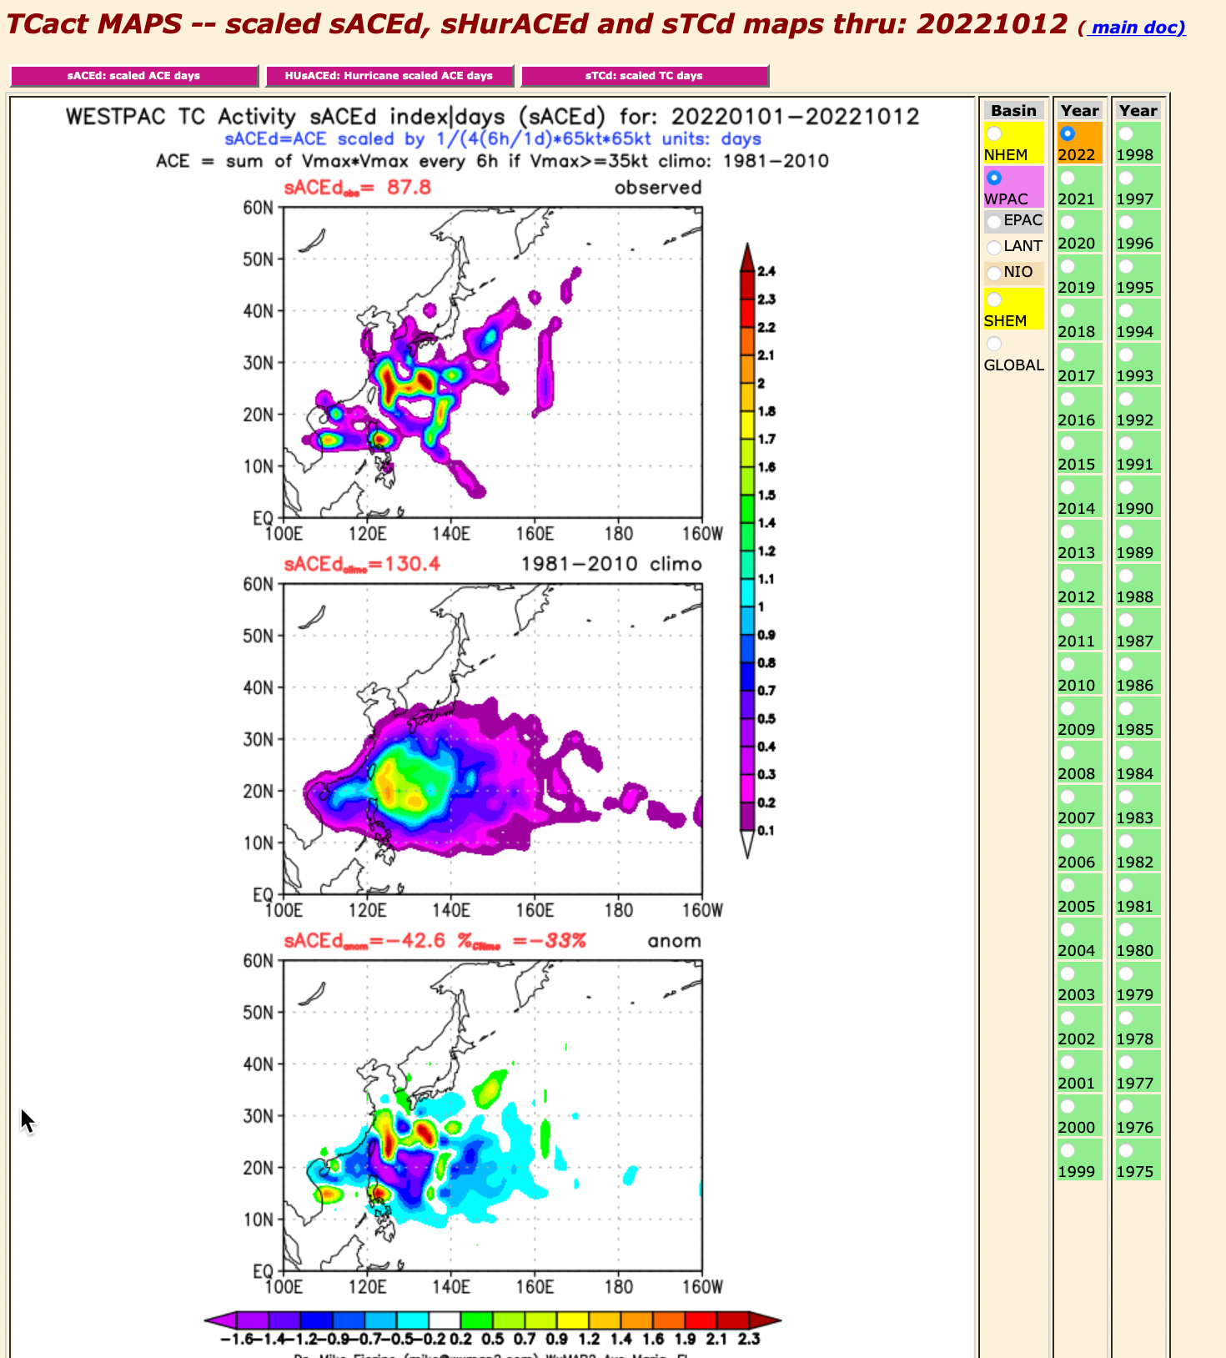
https://tcact.wxmap2.com maps

Slide 53
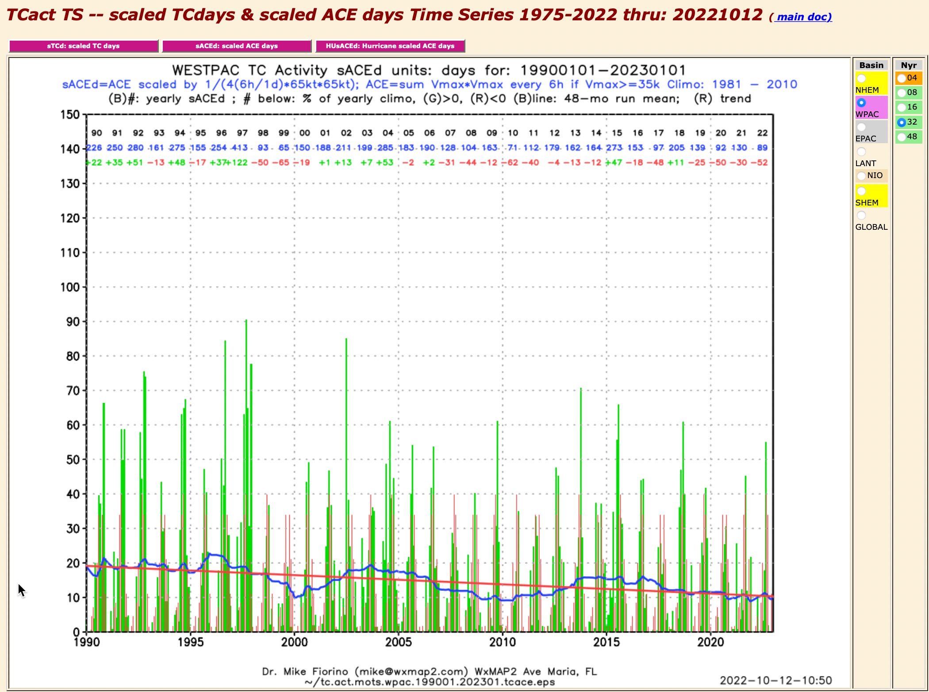
https://tcact.wxmap2.com time series

Slide 54
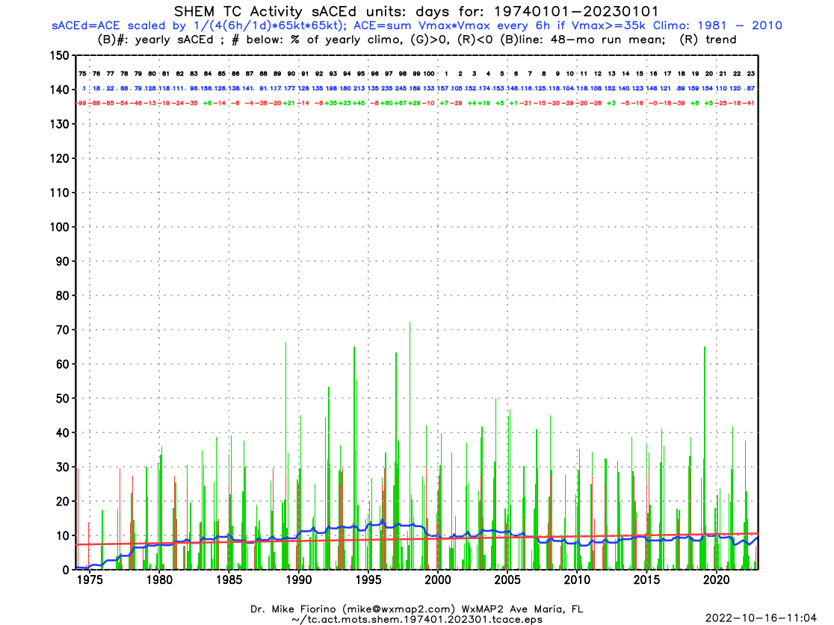
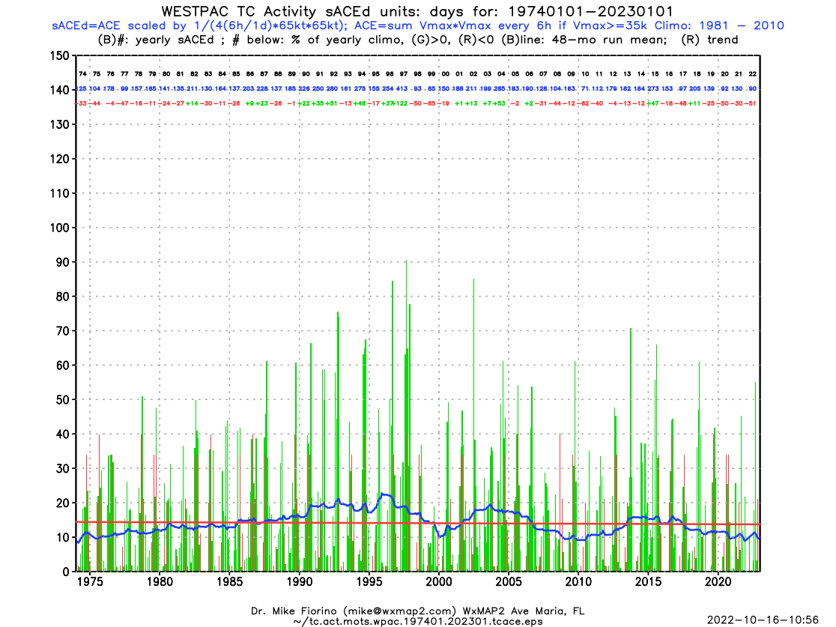
https://tcact.wxmap2.com

Slide 55
https://tcact.wxmap2.com

